Slide 1
Machine Learning 2024 (ML-2024) Lecture 9. Recurrent neural networks
by Alexei Valerievich Kornaev, Dr. habil. in Eng. Sc., Researcher at the RC for AI, Assoc. Prof. of the Robotics and CV Master’s Program, Innopolis University
Researcher at the RC for AI, National RC for Oncology n.a. NN Blohin
Professor at the Dept. of Mechatronics, Mechanics, and Robotics, Orel State University

Slide 2
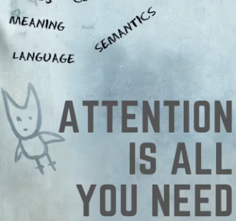

Agenda
ML-2024 by Alexei Kornaev
TEMPORAL DATA PROCESSING INTUITION
RECURRENT NEURAL NETWORKS (RNNs)
TRANSFORMERS (Ts)

Slide 3
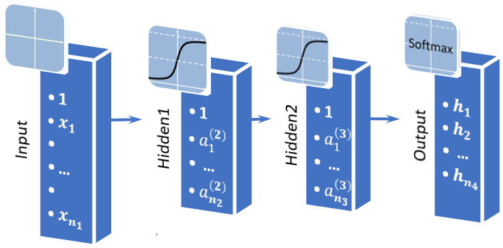
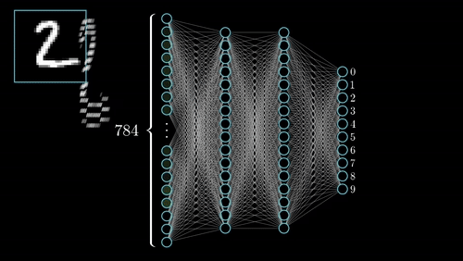
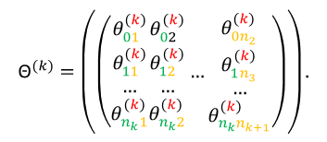
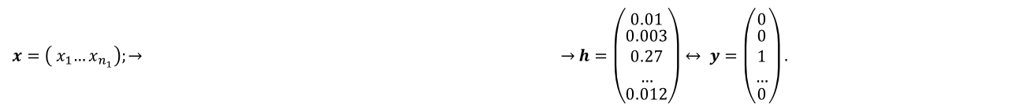
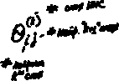
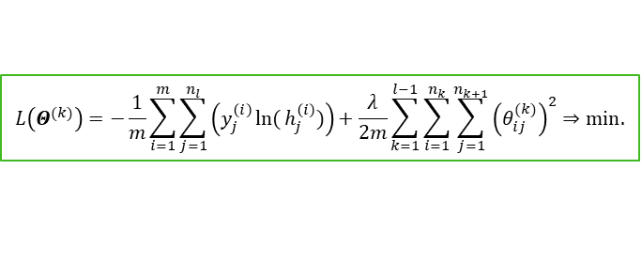
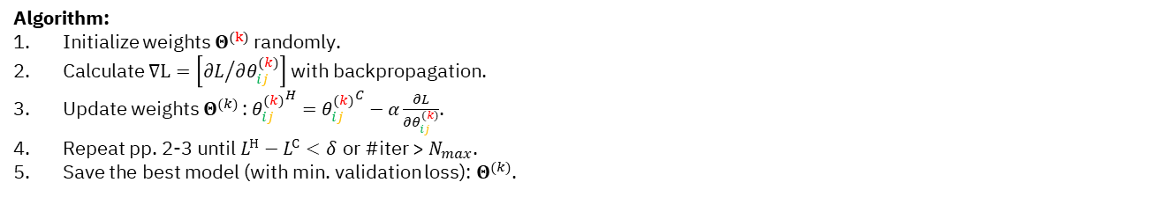
ML-2024 by Alexei Kornaev
Recap: feed-forward (fully-connected, multi-layer perceptron) neural networks intuition
$$L\left(Θ^{(k)}\right)=−\frac{1}{m}\sum_{i=1}^{m}{\sum_{j=1}^{n_{l}}{\left(y_{j}^{\left(i\right)}\ln{(}h_{j}^{\left(i\right)})\right)}}+\frac{λ}{2m}\sum_{k=1}^{l−1}{\sum_{i=1}^{n_{k}}{\sum_{j=1}^{n_{k+1}}{{\left(θ_{ij}^{(k)}\right)}^{2}}}}⇒min.$$
$$x=\left({ x}_{1}…x_{n_{1}}\right);→ →h=\left(\begin{matrix}0.01 \\ \begin{aligned}0.003 \\ 0.27 \\ …\end{aligned} \\ 0.012\end{matrix}\right)↔ y=\left(\begin{matrix}0 \\ \begin{aligned}0 \\ 1 \\ …\end{aligned} \\ 0\end{matrix}\right).$$
Algorithm:
Initialize weights $Θ^{(k)}$ randomly.
Calculate $∇L=\left[{∂L}/{∂θ_{ij}^{(k)}}\right]$ with backpropagation.
Update weights $Θ^{(k)}$: ${θ_{ij}^{(k)}}^{H}={θ_{ij}^{(k)}}^{C}−α\frac{∂L}{∂θ_{ij}^{(k)}}$.
Repeat pp. 2-3 until $L^{Н}−L^{С}<δ$ or #iter > $N_{max}$.
Save the best model (with min. validation loss): $Θ^{(k)}$.
$${\text{Θ}}^{(k)}=\left(\left(\begin{matrix}θ_{01}^{(k)} \\ \begin{aligned}θ_{11}^{(k)} \\ … \\ θ_{n_{k}1}^{(k)}\end{aligned}\end{matrix}\begin{matrix}θ_{02}^{(k)} \\ \begin{aligned}θ_{12}^{(k)} \\ … \\ θ_{n_{k}2}^{(k)}\end{aligned}\end{matrix}…\begin{matrix}θ_{0n_{2}}^{(k)} \\ \begin{aligned}θ_{1n_{3}}^{(k)} \\ … \\ θ_{n_{k}n_{k+1}}^{(k)}\end{aligned}\end{matrix}\right)\right).$$
3

Slide 4
ML-2024 by Alexei Kornaev
Why recurrent neural networks (RNNs) are good at sequences processing?
Sequential Memory: RNNs have a built-in memory mechanism that allows them to maintain information across time steps. This is crucial for tasks where the context from previous time steps is important for making predictions at the current time step.
Variable-Length Inputs: Unlike traditional neural networks, RNNs can handle sequences of variable lengths. This flexibility is essential for processing data where the length of the input sequence can vary, such as sentences in natural language or time series data.
Contextual Understanding: RNNs can capture dependencies and patterns in the data that span multiple time steps. This is particularly useful in tasks like language modeling, where understanding the context of a word often requires looking at the words that come before it.
Stateful Processing: RNNs can maintain a hidden state that summarizes the information from previous time steps. This stateful processing allows RNNs to model long-term dependencies in the data.
Versatility: RNNs can be adapted for various tasks by modifying their architecture. For example, Long Short-Term Memory (LSTM) networks and Gated Recurrent Units (GRUs) are specialized types of RNNs designed to better capture long-range dependencies and mitigate the vanishing gradient problem.
DeepSeek-V2.5 speaks
4

Slide 5
ML-2024 by Alexei Kornaev
Why transformers (Ts) are the best at sequences processing?
Parallel Processing: ransformers process entire sequences in parallel, unlike RNNs which process data sequentially. This parallelism significantly speeds up training and inference times.
Attention Mechanism: The core innovation of Transformers is the self-attention mechanism, which allows the model to weigh the importance of different elements in the input sequence when making predictions. This mechanism helps in capturing long-range dependencies more effectively.
Handling Long-Range Dependencies: Transformers can capture long-range dependencies more effectively than RNNs. The self-attention mechanism ensures that distant elements in the sequence can influence each other directly, without the need for intermediate steps. Unlike RNNs, which suffer from the vanishing gradient problem, Transformers do not have this issue due to their parallel processing and attention mechanism.
Scalability: Transformers can be scaled to handle very large datasets and complex tasks. The attention mechanism allows for the incorporation of more data without a significant increase in computational complexity.
Versatility: Transformers can be adapted for a wide range of sequence processing tasks, including natural language processing, speech recognition, and even computer vision (e.g., Vision Transformers).
State-of-the-Art Performance
DeepSeek-V2.5 speaks
5

Slide 6
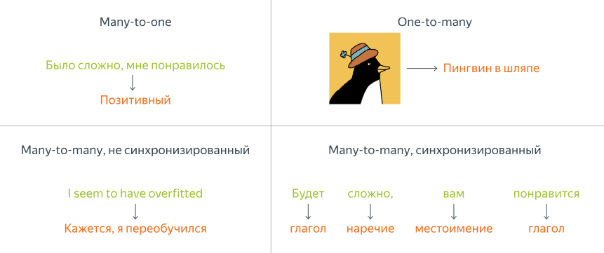
ML-2024 by Alexei Kornaev
Parts of a CNN: padding, pooling, striding
CNN utilizes the features of the visual cortex, where simple cells are activated by simple features (such as lines), and complex cells by combinations of activations of simple cells. The CNN is associated with the mathematical operation of convolution for reducing matrix sizes.
Yandex Handbook on ML
6

Slide 7

ML-2024 by Alexei Kornaev
Self-study and
self-test questions
Why does ReLU work so well?
How to make convolution preserve the image size?
How many trainable parameters in a kernel of size [3,3,2]?
Is it possible to avoid using fully-connected layers in CNNs?
How does 3D CNNs work?
How does hyperspectral image processing work?
7

Slide 8

ML-2024 by Alexei Kornaev
Thank you for your attention!
a.kornaev@innopolis.ru, @avkornaev

Slide 9
ML-2024 Notes
9

Slide 10
ML-2024 Notes
10

Slide 11
ML-2024 Notes
11

